Slide 1
Generative Adversarial Nets
In Advances in neural information processing systems (2014)

Slide 2
Contents
Generative Adversarial Nets (GAN)
GAN, other version
Generative Adversarial Nets (GAN): How
Objective Function
Experiment
Conclusion

Slide 3
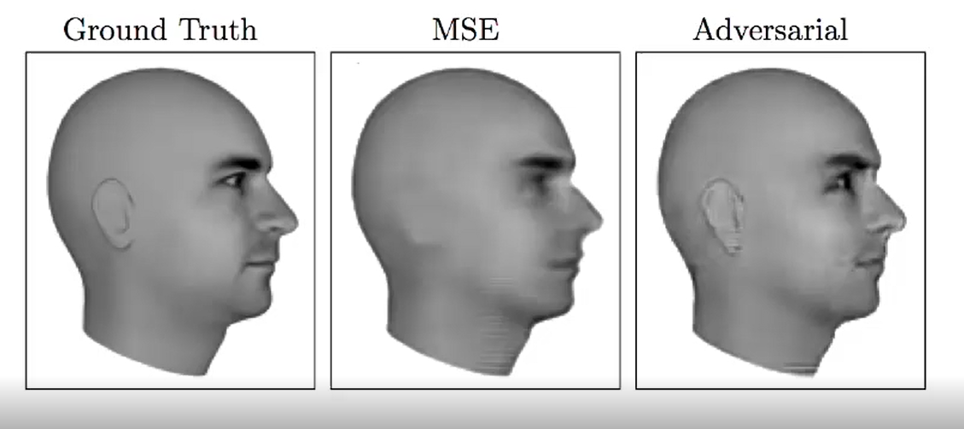
Generative Adversarial Nets (GAN)
GAN makes samples which are very similar to real data
Lotter, W., Kreiman, G., & Cox, D. (2015). Unsupervised learning of visual structure using predictive generative networks. arXiv preprint arXiv:1511.06380.

Slide 4
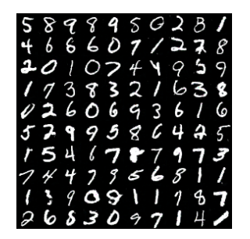
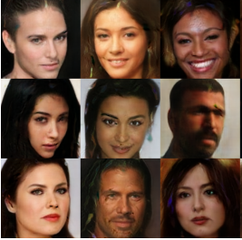
Generative Adversarial Nets (GAN)
GAN makes samples which are very similar to real data
Salimans et al., Improved techniques for training gans. In Advances in Neural Information Processing Systems (2016; pp. 2226-2234)

Slide 5
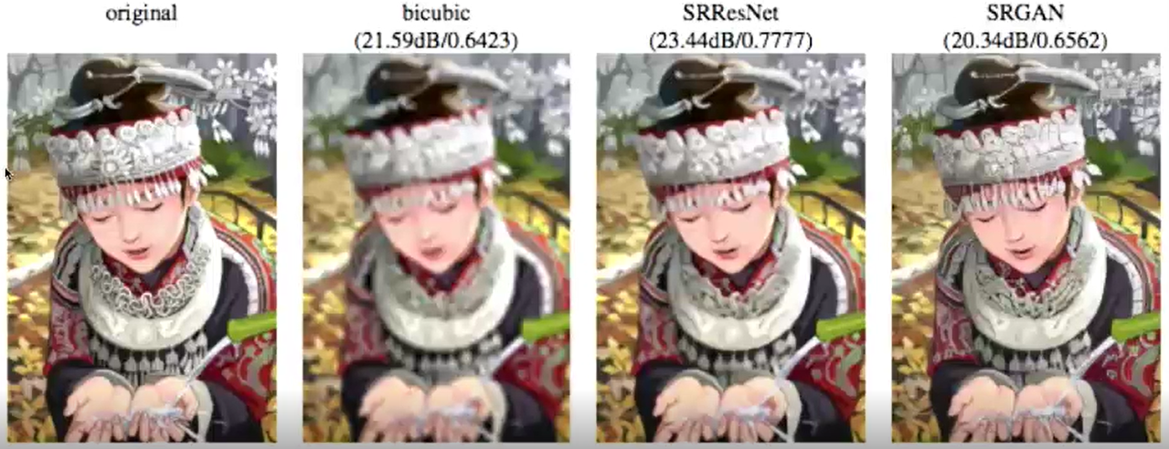
Generative Adversarial Nets (GAN)
GAN makes samples which are very similar to real data
Ledig, C., Theis, L., Huszár, F., Caballero, J., Cunningham, A., Acosta, A., ... & Shi, W. (2016). Photo-realistic single image super-resolution using a generative adversarial network. arXiv preprint arXiv:1609.04802.

Slide 6
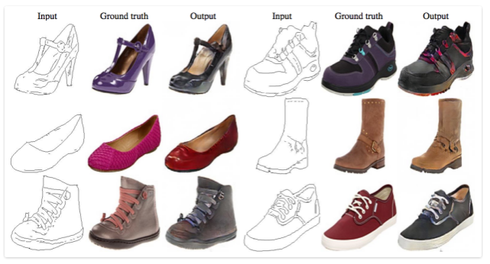
GAN, other version
The output of other version of GAN is quite interesting
Input
Output
Input
Output
Isola, P., Zhu, J. Y., Zhou, T., & Efros, A. A. (2016). Image-to-image translation with conditional adversarial networks. arXiv preprint arXiv:1611.07004.

Slide 7
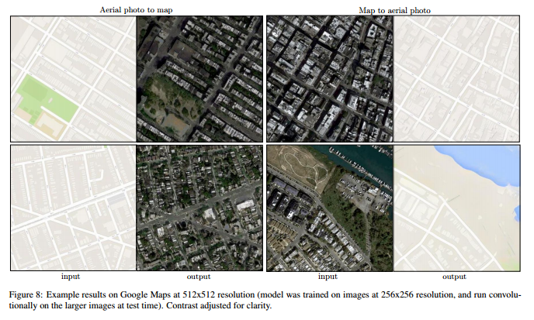
GAN, other version
The output of other version of GAN is quite interesting
Input
Output
Input
Output
Isola, P., Zhu, J. Y., Zhou, T., & Efros, A. A. (2016). Image-to-image translation with conditional adversarial networks. arXiv preprint arXiv:1611.07004.

Slide 8
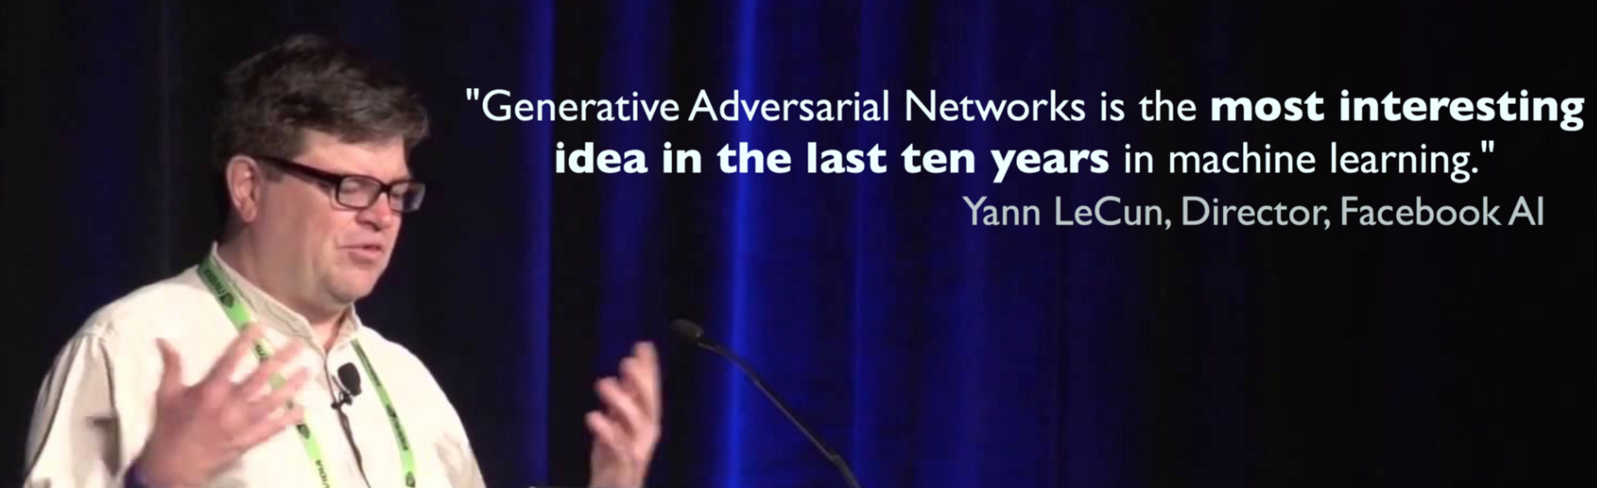
https://medium.com/@devnag/generative-adversarial-networks-gans-in-50-lines-of-code-pytorch-e81b79659e3f

Slide 9
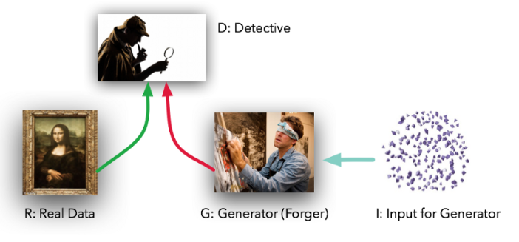
Generative Adversarial Nets (GAN): How
GAN makes samples to make Detector difficult
https://medium.com/@devnag/generative-adversarial-networks-gans-in-50-lines-of-code-pytorch-e81b79659e3f

Slide 10
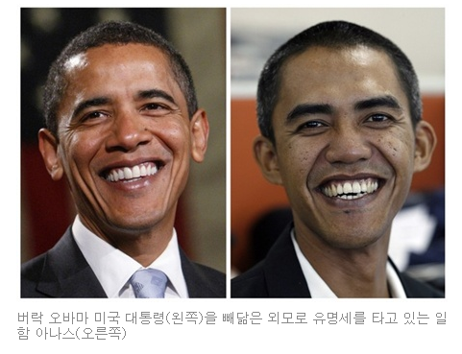
Generative Adversarial Nets (GAN): How
GAN makes samples to make Detector difficult
D
Px
Pg
G
Z = Noise ~ Uniform or Normal
Real Data: Obama
Generated Data(?): Person similar to Obama?
https://medium.com/@devnag/generative-adversarial-networks-gans-in-50-lines-of-code-pytorch-e81b79659e3f

Slide 11
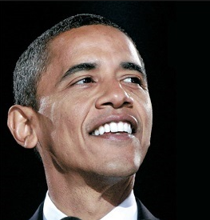
Generative Adversarial Nets (GAN): How
GAN makes samples to make Detector difficult
D
Px
Pg
G
Z = Noise ~ Uniform or Normal
Real Data: Obama
Generated Data(?): Person similar to Obama?
https://medium.com/@devnag/generative-adversarial-networks-gans-in-50-lines-of-code-pytorch-e81b79659e3f

Slide 12
Generative Adversarial Nets (GAN): How
GAN makes samples to make Detector difficult
D
Px
Pg
G
Z = Noise ~ Uniform or Normal
Real Data: x ~ Px
https://medium.com/@devnag/generative-adversarial-networks-gans-in-50-lines-of-code-pytorch-e81b79659e3f

Slide 13
Generative Adversarial Nets (GAN): How
GAN makes samples to make Detector difficult
D
Px
Pg
G
Z = Noise ~ Uniform or Normal
Real Data: x ~ Px
Noise space: Z, where Generated Samples occur
https://medium.com/@devnag/generative-adversarial-networks-gans-in-50-lines-of-code-pytorch-e81b79659e3f

Slide 14
Generative Adversarial Nets (GAN): How
GAN makes samples to make Detector difficult
D
Px
Pg
G
Z = Noise ~ Uniform or Normal
Real Data: x ~ Px
Generated Data: g ~ Pg
Noise space: Z, where Generated Samples occur
https://medium.com/@devnag/generative-adversarial-networks-gans-in-50-lines-of-code-pytorch-e81b79659e3f

Slide 15
Generative Adversarial Nets (GAN): How
GAN makes samples to make Detector difficult
D
Px
Pg
G
Z = Noise ~ Uniform or Normal
Real Data: x ~ Px
Generated Data: g ~ Pg
Detector: D, Classifier
Noise space: Z, where Generated Samples occur
https://medium.com/@devnag/generative-adversarial-networks-gans-in-50-lines-of-code-pytorch-e81b79659e3f

Slide 16
Generative Adversarial Nets (GAN): How
GAN makes samples to make Detector difficult
D
Px
Pg
G
Z = Noise ~ Uniform or Normal
D: ??
…
G, D are updated iteratively
Final: Hard to Detect
https://medium.com/@devnag/generative-adversarial-networks-gans-in-50-lines-of-code-pytorch-e81b79659e3f

Slide 17
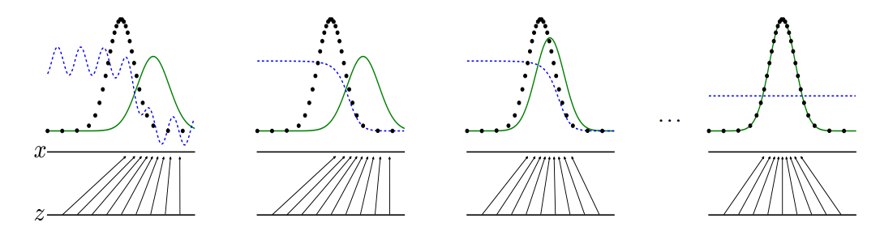
Generative Adversarial Nets (GAN): How
GAN makes samples to make Detector difficult
D
Px
Pg
G
Z = Noise ~ Uniform or Normal
D is trained
G, Pg is updated
Pg = Px
Px
D
Pg
G

Slide 18
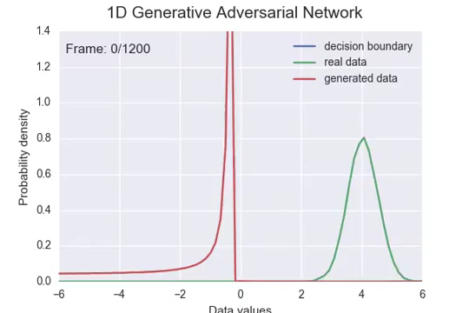
Generative Adversarial Nets (GAN): How
GAN makes samples to make Detector difficult
https://www.youtube.com/watch?v=0r3g7-4bMYU

Slide 19
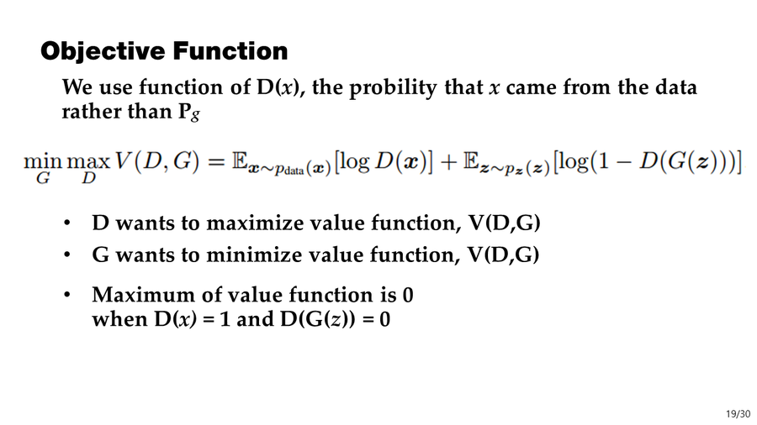

Slide 20
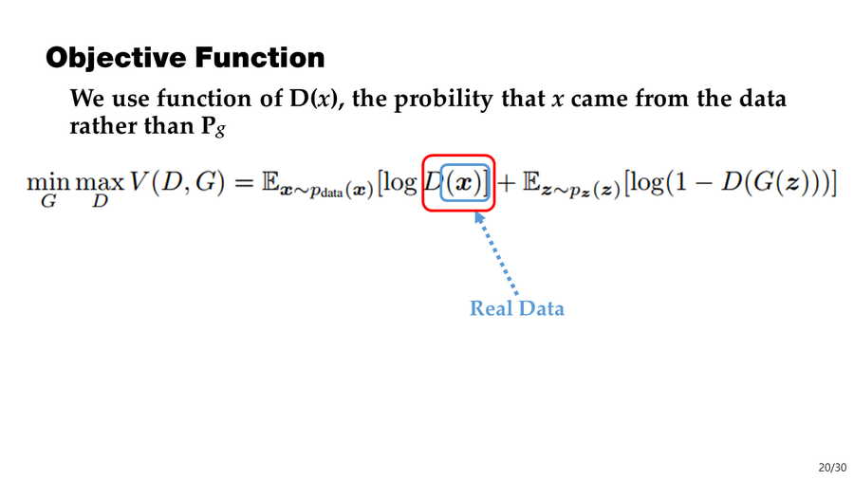

Slide 21
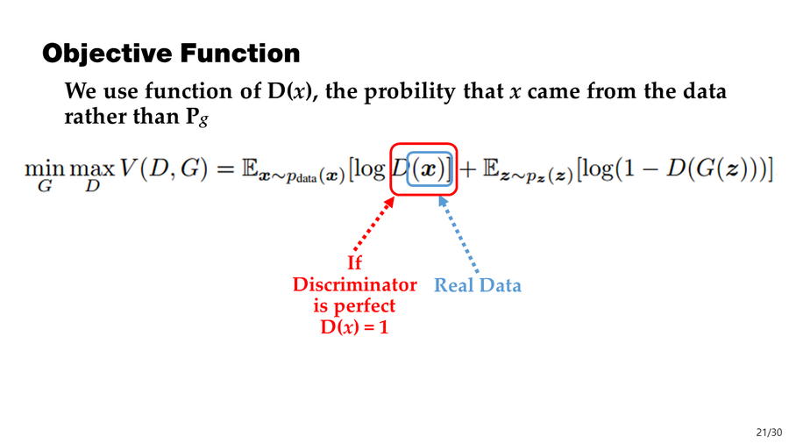

Slide 22
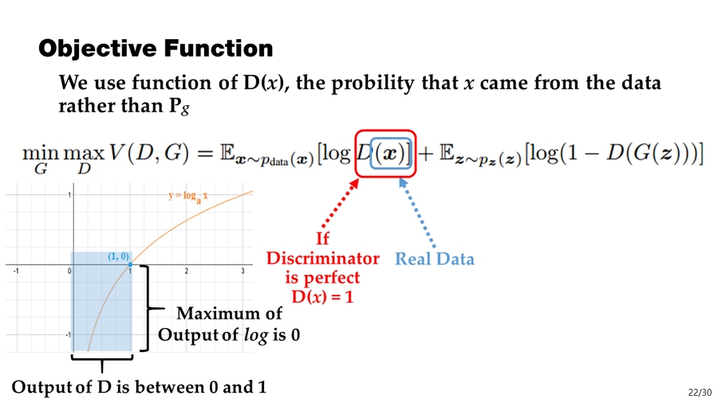

Slide 23
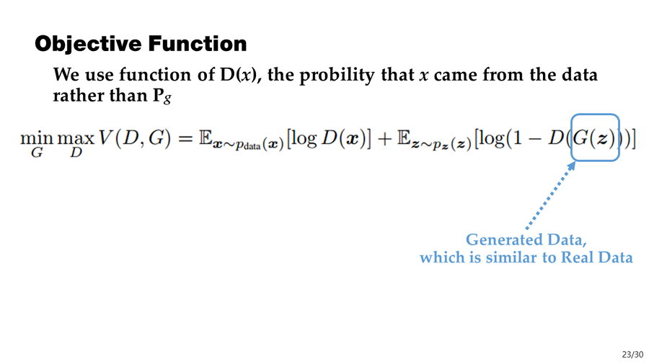

Slide 24
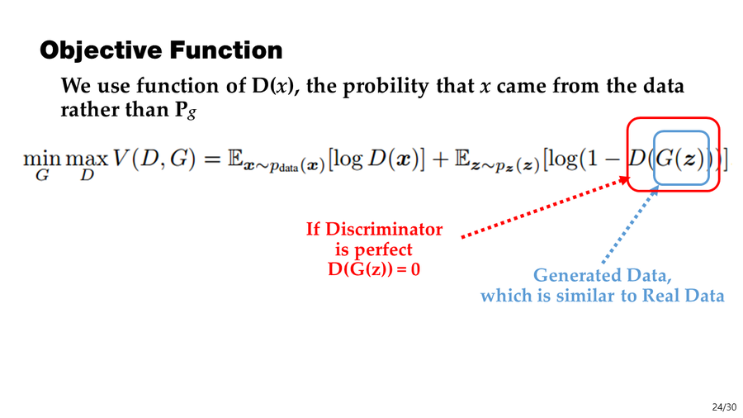

Slide 25
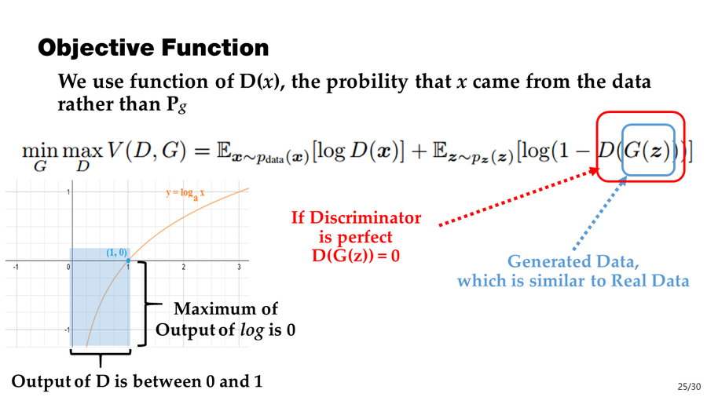

Slide 26


Slide 27
Objective Function
We use function of D(x), the probility that x came from the data rather than Pg
V(D, G)
D
G(Z)
Input: Real Data, Generated Data
Input: Z

Slide 28
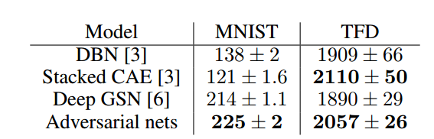
Experiment

Slide 29
Conclusion
GAN makes samples which are very similar to real data
By making samples to make Detector difficult

